Slide 1
Outline
Discovery of Notch up-regulation in hypoxia-selected flies
Notch over-expression potentiating survival during hypoxia
Mechanisms of Notch-mediated hypoxic survival
Notes:
First I will discus previous work done in the Haddad lab. Next I will show data implicating Notch in survival during chronic hypoxia. Next I will talk about mechanisms of Notch-mediated hypoxic survival. Finally, I will end with my conclusions.

Slide 2
The Role of Notch in Survival During Chronic Hypoxia
DeeAnn Visk
Division of Biology, UCSD
Dissertation Defense
Dr. Gabriel Haddad, Advisor
July 21st , 2011
Notes:
Welcome all to my dissertation defense. Today I will be discussing the role of Notch in Survival During Chronic Hypoxia

Slide 3
Why Study Hypoxia?
Hypoxia is a major contributing factor leading to damage during heart attack, stroke, asthma, and high altitude sickness
Cost of Cardiovascular Disease and stroke for 2010 is estimated to be half a trillion dollars (Lloyd-Jones, 2010)
Studies of hypoxia tolerance and vulnerability to hypoxia are crucial for developing therapies for these diseases
Notes:
Hypoxia is a deficiency in the amount of oxygen reaching tissues. This lack of oxygen contributes greatly to the pathology of strokes, heart attacks, asthma and high altitude sickness. The direct and indirect cost of cardiovascular disease and stroke in the US is estimated to be 500 billion dollars. To find treatments for these conditions it is necessary to study both susceptibility and resistance to hypoxia.

Slide 4

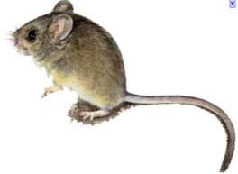
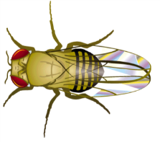
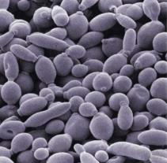
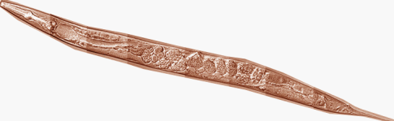
Model Organisms Used to Study Hypoxia
Notes:
The model organisms employed in the study of hypoxia include humans, rodents, flies, worms and yeast. [Click to animate] The Haddad lab studies hypoxia using humans, rodents, and fruit flies.

Slide 5
Why Use Fruit Flies?
Numerous genes and pathways conserved from flies to humans
Many genetic tools available
Short generation time
Many progeny
Notes:
There are several benefits to studying fruit flies. Many pathways and disease states found in flies are conserved through humans. Genetic tools, including the sequencing of the entire genome, are readily available. Flies have a short generation time with many progeny. While previous studies in the Haddad lab have used classic genetic screens for hypoxia tolerance and susceptibility, there is a new approach used in the Haddad lab that really intrigued me and led me to join the lab. This approach is the experimental selection of Drosophila under lower and lower oxygen levels.

Slide 6
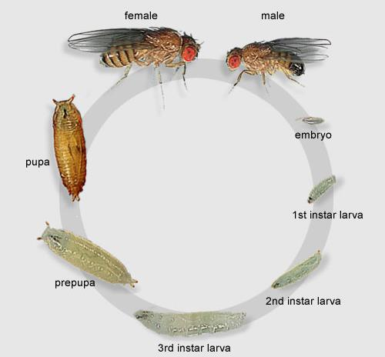
“Darwinian” Selection Experiment
F1
F4
F8
F13
F32
P
21%
8%
Feb 05, 2002
7%
6%
O₂
5%
4%
from: FlyMove (http://pbio07.uni-muenster.de/FlyMove/)
Notes:
The selection experiment was initiated in 2002 with 27 lines of fruit flies isolated in the wild (for a diverse genetic background), crossed en masse and then subjected to lower and lower oxygen levels for several generations. In parallel, control flies where placed in similar chambers non-hypoxic room air. The selection started at 8%. This level was experimentally determined to be a point where 80% of the flies survived to adulthood. To determine what changes allowed this survival in low oxygen, an expression microarray was completed at F18 on 3rd instar larvae.

Slide 7
Differentially Expressed Pathways in Larvae
Name of pathway | P-value | Number of Genes Changed | Total Number of Genes in Pathway
Role of IAP-proteins in apoptosis | 0.000564 | 6 | 36
Notch signaling pathway | 0.000878 | 6 | 39
Caspase cascades | 0.000951 | 7 | 54
Role of APC in cell cycle regulation | 0.002916 | 4 | 34
Role of SUMO in p53 regulation | 0.002933 | 5 | 21
Role of Akt in hypoxia induced HIF1 activation | 0.003264 | 6 | 50
Ligand-dependent transcription of retinoid-target genes | 0.003707 | 10 | 125
PTEN pathway | 0.005271 | 6 | 55
Glycolysis and Gluconeogenesis part 2 | 0.005752 | 3 | 13
Receptor-mediated HIF regulation | 0.005976 | 5 | 40
PIP3 signaling in cardiac myocytes | 0.006789 | 7 | 76
EGFR signaling via PIP3 | 0.007492 | 4 | 27
Insulin receptor signaling pathway | 0.008141 | 5 | 43
Role of AP-1 in regulation of cellular metabolism | 0.008141 | 5 | 43
WNT signaling pathway, part1, degradation of beta-catenin in the absence of WNT signaling | 0.008542 | 4 | 28
Notch Signaling Pathway p= 0.00878
Notes:
Analysis of the microarray data lead to this table of pathways that are differentially expressed in 3rd instar larvae. From these pathways, the Notch signaling pathway was chosen for further study. [Click to animate] Given the very low p-value, the Notch signaling pathway is highly significant in this analysis.

Slide 8
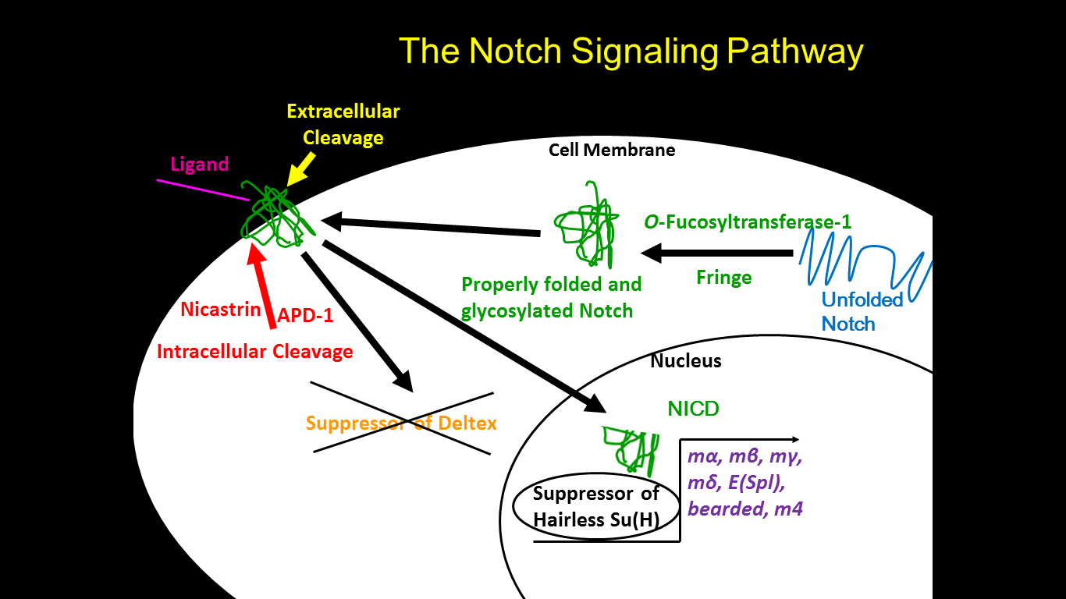
Activation of Notch Pathway in Hypoxia-Selected Flies
GENE
FOLD INCREASE
Su(dx)
0.62
fringe
1.55
apd-1
1.63
mβ
1.64
bearded
1.65
nicastrin
1.72
E (Spl)
1.81
mγ
1.92
mδ
2.20
m4
2.21
mα
2.27
O-fucosyltransferase 1
2.74
Notes:
The illustration on the left shows the Notch signaling pathway is relation to the gene that were differentially expressed in the microarray analysis. First, the nascent Notch is properly glycosylated and folded by o-fucosyltransferase and fringe. Next Notch is inserted into the cell membrane. Upon recognition of a ligand, the extra-cellular portion of Notch is cleaved, followed by an intracellular cleaved mediated by the gamma-secretase complex, of which nicastrin and anterior pharnyx defective (aph) are part. The Notch Intracellular Domain (NICD) then translocates to the nucleus, where at acts as a transcriptional co-activator with Suppressor of Hairless to activate downstream targets of Notch at the Enhancer of Split locus, including m alpha, beta, gamma, delta, m4, and bearded. To increase Notch signaling, simply increase the level of NICD. Now lets us see how these genes changed in the microarray. [Click to animate] Fringe and O-fuc are un-regulated as are nicastrin and apd. Several downstream targets of Notch also show increased expression levels. The Suppressor of Deltex protein inhibits Notch signaling; hence its down regulation increases Notch signaling.

Slide 9
Why study Notch?
Conservation of Notch pathway from flies to humans
Notch is one of the key pathways involved in regulating development
Published work linking Notch with hypoxia
Well studied pathway
Notes:
In addition to the very low p-value, the Notch pathway was chosen for further study for several reasons. Not only is Notch conserved from flies to humans, it is involved in the regulation of development. Additionally, Notch has been previously linked with hypoxia and is a well studied pathway.

Slide 10
Outline
Discovery of Notch up-regulation in hypoxia-selected flies
Notch over-expression potentiating survival during hypoxia
Mechanisms of Notch-mediated hypoxic survival
Notes:
Now we are moving onto to the second section of my talk, [Click to animate] where I show NICD over-expression potentiates survival during low oxygen.

Slide 11
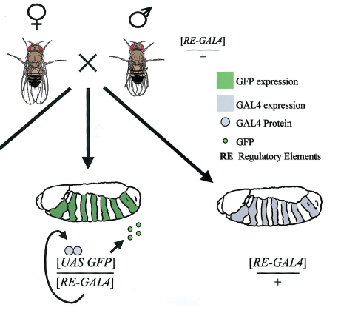
Drosophila UAS-GAL4 System
UAS GFP
UAS GFP
RE-GAL4
RE-GAL4
Modified from Duffy JB, 2002
Notes:
To determine the exact when and where of NICD over-expression potentiates survival under hypoxia, the Drosophila UAS-GAL4 system was employed. In this system a transgenic fly containing a regulatory element upstream of the GAL4 coding sequence. When expressed, GAL4 binds to the UAS (upstream activating sequence) and activated transcription of the gene of interest, in this case GFP (green fluorescent protein). The transgenic fly containing the GAL4 construct is referred to the “driver” fly as it drives expression of the gene of interest.

Slide 12
Experimental Paradigm
Cross UAS-NICD flies to GAL4 flies
Allow 48hrs for egg laying in 21% oxygen followed by 3 to 4 weeks development in 5% oxygen
Count the number of live adult flies every day until all flies are dead
21% oxygen
5% oxygen
48hr
3 to 4 weeks
Adult Post-Eclosion Survival
Eclosion Rate
Notes:
The experiment used to study the progeny of these crosses is illustrated here. UAS-NICD flies are crossed to a variety of GAL4 drivers. The parents are allowed to mate and lay eggs for 48 hours. The parents are then transferred to a control vial and the eggs are then placed in 5% oxygen and allowed to develop to adults (taking 3 to 4 weeks). The number of empty vs. not-empty pupal cases are counted, yielding an eclosion rate. Adults that were eclosed were transferred to a new vial daily. [Click to animate] This gives a measure of adults post-eclosion survival in continued hypoxia. Next here is a list of GAL4 drivers screened with this experiment.

Slide 13

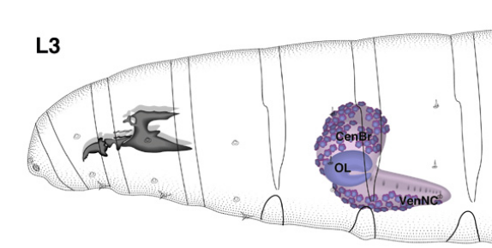
Where and When are These GAL4 Drivers Expressed?

Slide 14
GAL4 Drivers Screened
Expression Pattern | Percent Eclosed in 5% Oxygen | Adult Survival Post- Eclosion
glial cells that produce the glutamate transporter EAAT1 | 95 | excellent
glia (embryonic stage 16 to adult) and cardia | 92 | excellent
eclosion hormone-expressing neurons | 94 | good
nervous system | 91 | good
RP2, aCC, and pCC neurons | 90 | good
ventrolateral neurons of the brain and a small number of cells in the CNS | 82 | good
EcR-A-expressing neurons destined for apoptosis at metamorphosis, also in imaginal discs | 25 | good
antennal olfactory receptors neurons and processing centers in CNS, also imaginal precursors | 74 | fair
embryonic peritracheal cells and pericardial cells | 69 | fair
nervous system | 62 | fair
U/CQ neurons | 58 | fair
mushroom bodies | 55 | fair
multiple dendritic neurons oenocytes and chordotonal organs | 49 | fair
salivary gland | 69 | poor
amnioserosa and salivary glands | 53 | poor
primarily in mushroom body | 29 | poor
atonal pattern in brain external sensory organ precursor cells | 26 | poor
third instar fat body | 22 | poor
embryonic midline glial cells and MP1 neurons | 14 | poor
giant descending neuron circuit | 12 | poor
adult brain muscles and cardia | 5 | poor
brain strong expression in the alpha and beta lobes of the mushroom body weaker expression in alpha', beta', and gamma lobes | 6 | poor
larval epidermis and in brain cells starting at the mid-third instar transition | 0 | NA
motor neurons | 0 | NA
dopaminergic and serotonergic neurons | 0 | NA
pattern of the da gene | 0 | NA
dopaminergic and serotonergic neurons | 0 | NA
Notes:
As you can see, a large number of GAL4 drivers were screened. These driver express NICD in a variety of tissues, such as variety of neurons, salivary glands, fat body, during different developmental times. Next, we look at survival results during hypoxia. [Click to animate]

Slide 15
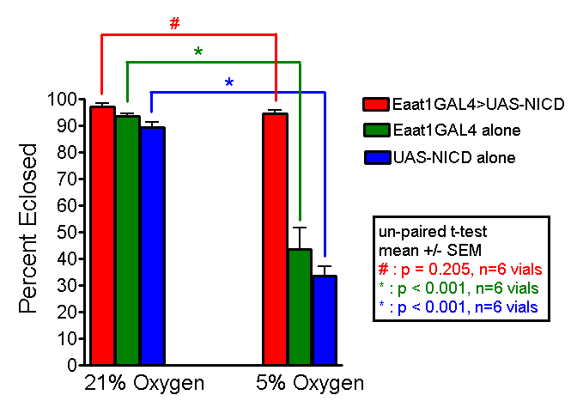
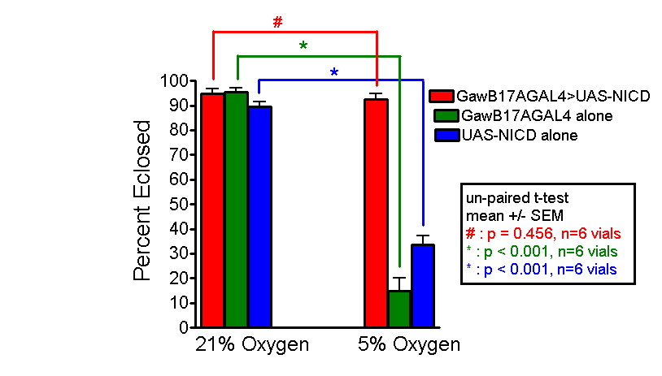
Eclosion Rate for
Eaat1>NICD and 17A>NICD

Slide 16
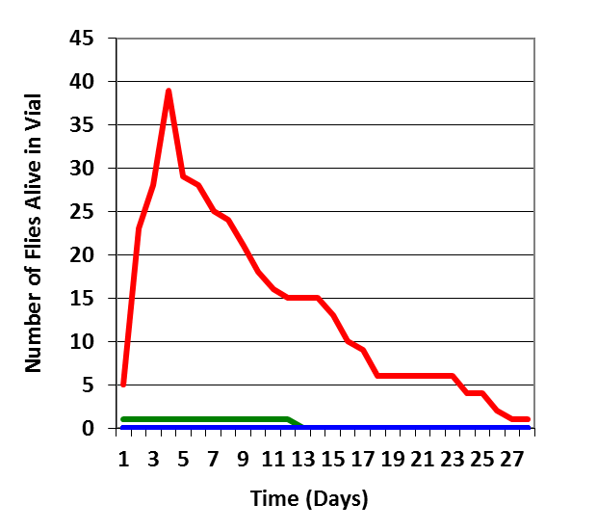
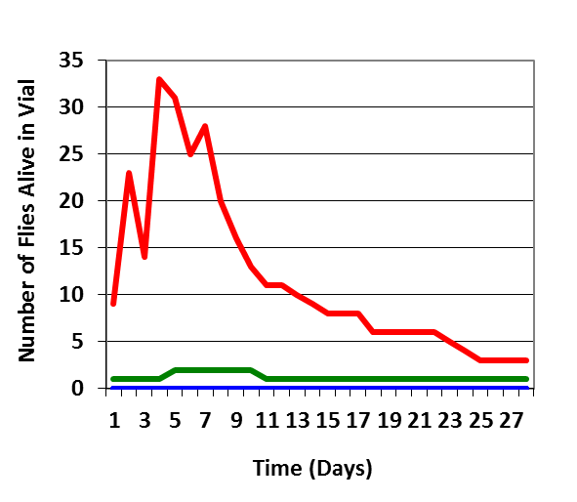


Adult Post-Eclosion Survival for
Eaat1>NICD and 17A>NICD

Slide 17
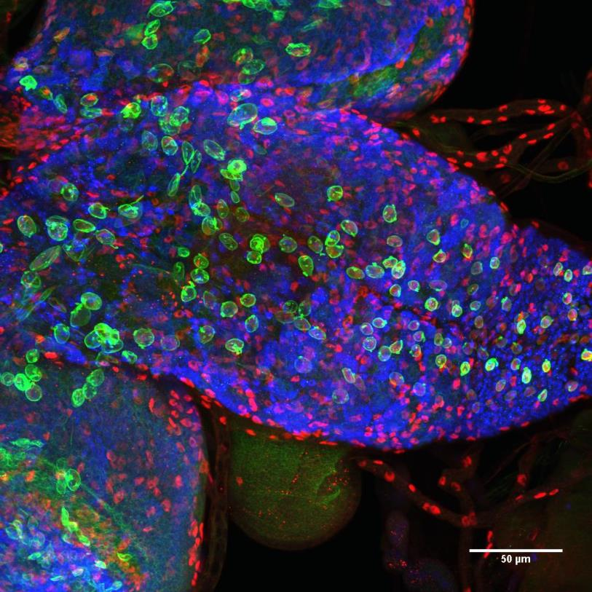
Eaat1>NICD Expression Pattern in 3rd Instar Brains
Red = Repo (glia)
Green = NICD
Blue = Elav (neuron)
70% NICD⁺ Repo⁺
0% NICD⁺ Elav⁺
30% NICD⁺ Repo⁻ Elav⁻

Slide 18
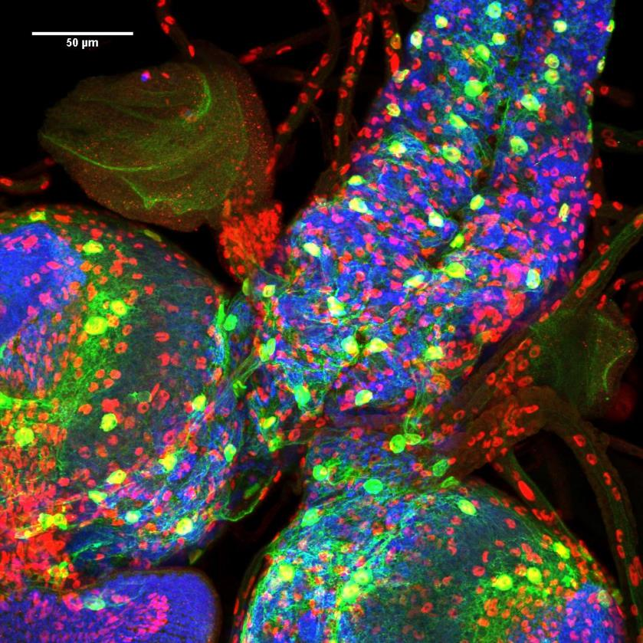
17A>NICD Expression Pattern
in 3rd instar brains
Red = Repo (glia)
Green = NICD
Blue = Elav (neuron)
90% NICD⁺ Repo⁺
6% NICD⁺ Elav⁺
4% NICD⁺ Repo⁻ Elav⁻

Slide 19
Outline
Discovery of Notch up-regulation in hypoxia-selected flies
Notch over-expression potentiating survival during hypoxia
Mechanisms of Notch-mediated hypoxic survival

Slide 20
Experimental Design
Eaat1 Glia
UAS-NICD
Eaat1-GAL4
Increased Survival in Chronic Hypoxia
Gene(s)
Eaat1 Glia
No connection to Notch pathway
UAS-NICD
Yes
Increased Survival During Chronic Hypoxia?
Eaat1-GAL4
UAS-Gene-RNAi
Gene(s)
Possible Connection to Notch pathway
No

Slide 21
Fly Line Stably Over-expressing NICD in Eaat1 Pattern
Let N = UAS-NICD on 3rd chromosome
E = Eaat1-GAL4 on 2nd chromosome
Sb = TM3 balancer with Stubble marker on 3rd chromosome
CyO = CyO balancer on 2nd chromosome
Ap = Apterous, mitten-shaped wing marker, 2nd chr., T (2;3) ap [Xa], ap [Xa]
The 1st (X) chromosome will be ignored, since it does not carry DNA of interest
Step1
P1 +/+;N/N X Ap/CyO;+/Sb
F1 select for only CyO and Sb flies +/CyO;N/Sb X +/CyO;N/Sb (self)
F2 select for only CyO flies +/CyO; N/N
Step2
P1 E/E;+/+ X Ap/CyO;+/Sb
F1 select for only CyO and Sb flies E/CyO;+/Sb X E/CyO;+/Sb (self)
F2 select for only Sb flies E/E;+/Sb
Step3
P1 (F2 from Crosses 1 and 2) E/E;+/Sb X +/CyO;N/N
F1 select for only CyO and Sb E/CyO;N/Sb X E/CyO;N/Sb (self)
F2 self the F1 for balanced stock E/CyO;N/Sb or E/E;N/Sb or E/CyO;N/N or E/E;N/N
NICKNAME: EN line

Slide 22
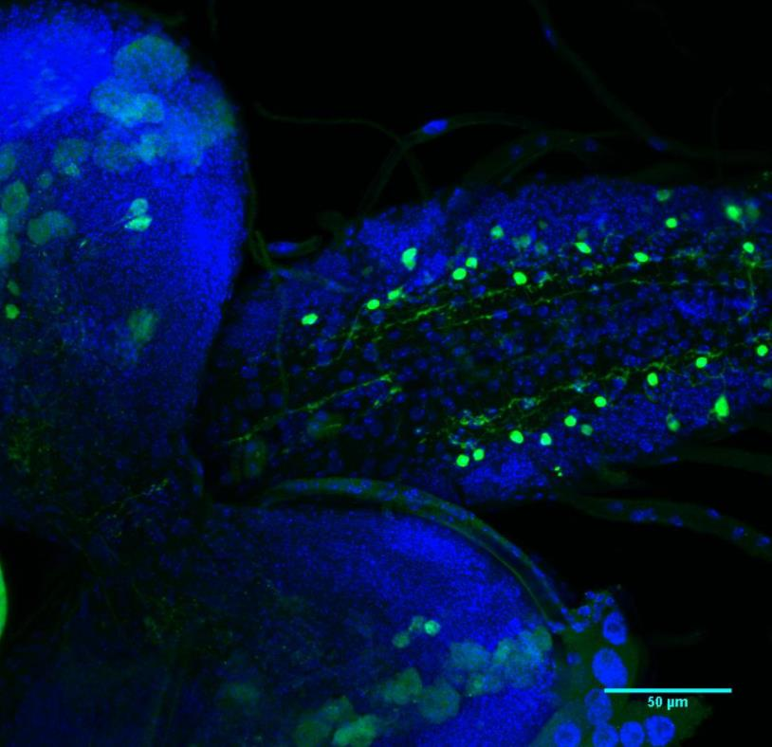
NICD Over-expression Leads to Transcriptional Activity
EN X Su(H)-lacZ
Green = LacZ staining
Blue = DAPI

Slide 23
Hypotheses Tested
Transcriptional up-regulation of canonical Notch targets (m-α)
Metabolic modification (pyruvate dehydrogenase—PDH)
Enhanced survival signal (Akt)
Stress response pathway (Relish)

Slide 24
Canonical Notch Signaling
Classic downstream genes of Notch signaling up-regulated in the original microarray including m-α
Inhibit m-α in NICD over-expression background and see if flies still survive

Slide 25
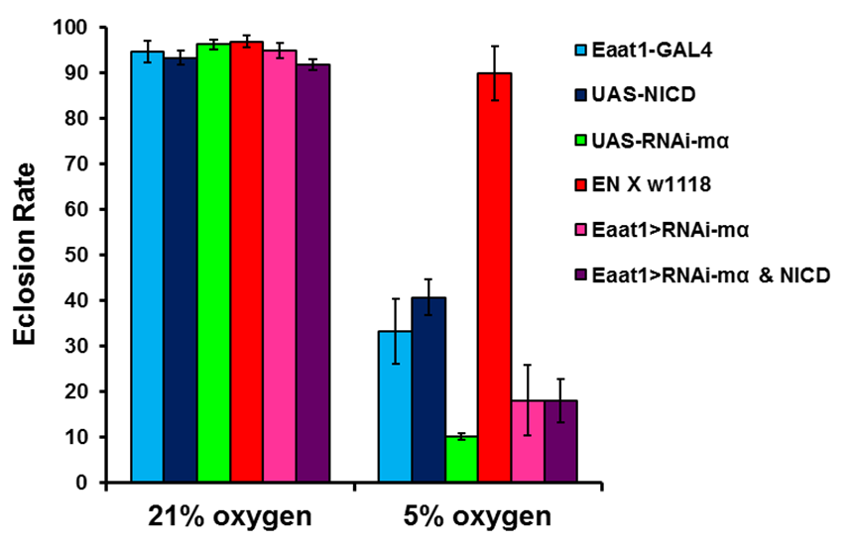
Notch Confers Hypoxia Tolerance Via Activation of Canonical Target Genes

Slide 26
Metabolism Modification
Hairy, a downstream target of Notch in mammals, acts as a metabolic switch; shown to down-regulate metabolism
Pyruvate dehydrogenase (PDH) down regulated in worm microarray (Mabon et al., 2009) and the original microarray

Slide 27
Survival Signal
Notch interacts with Akt via inactivation of the PTEN, Akt inhibitor, in normal development of megakaryocytes, (Cornejo et al., 2011)
In T-cell acute lymphoblastic leukemia, those cancers without PTEN (which is inhibited by Notch) cannot be killed by inhibiting the Notch pathway (Gutierrez and Look, 2007)
Akt pathway up-regulated in the original microarray

Slide 28
Stress Response
Innate immunity pathways and their targets are up-regulated in the Haddad lab microarray

Slide 29
Notch Confers Hypoxia Tolerance Via Activation of Stress Response Genes

Slide 30
Model of NICD and Stress Pathways Conferring Hypoxia Tolerance
Eaat1 Glia
Imd/Toll pathways
NICD
Nucleus
Relish activity
via binding to NICD*
Increased Survival During Chronic Hypoxia
*Based on Shin et al., 2006

Slide 31
Conclusions
Up-regulation of Notch signaling potentiates survival during chronic hypoxia
Notch mediates hypoxic survival through canonical target genes (m-α) and via stress response pathways (Relish)

Slide 32
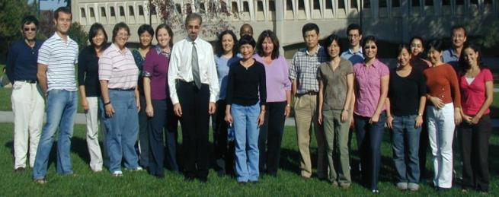
Acknowledgements
Everyone in the Haddad Lab
Dr. James Posakony
Dr. Joseph Fontana
Dr. Carol Weaver
Dr. Kristina Schimmelpfeng-Henthorn
Notes:
32
Many people have contribute to this project, but most of all, I would like to thank Dan Zhou and Gaby for all their help and support. All the members of the Haddad Lab have also been very helpful.

